Slide 1
Obesity and Maintaining a Healthy Weight
Presented By
Date 00.00.2018 / Venue or Location

Slide 2
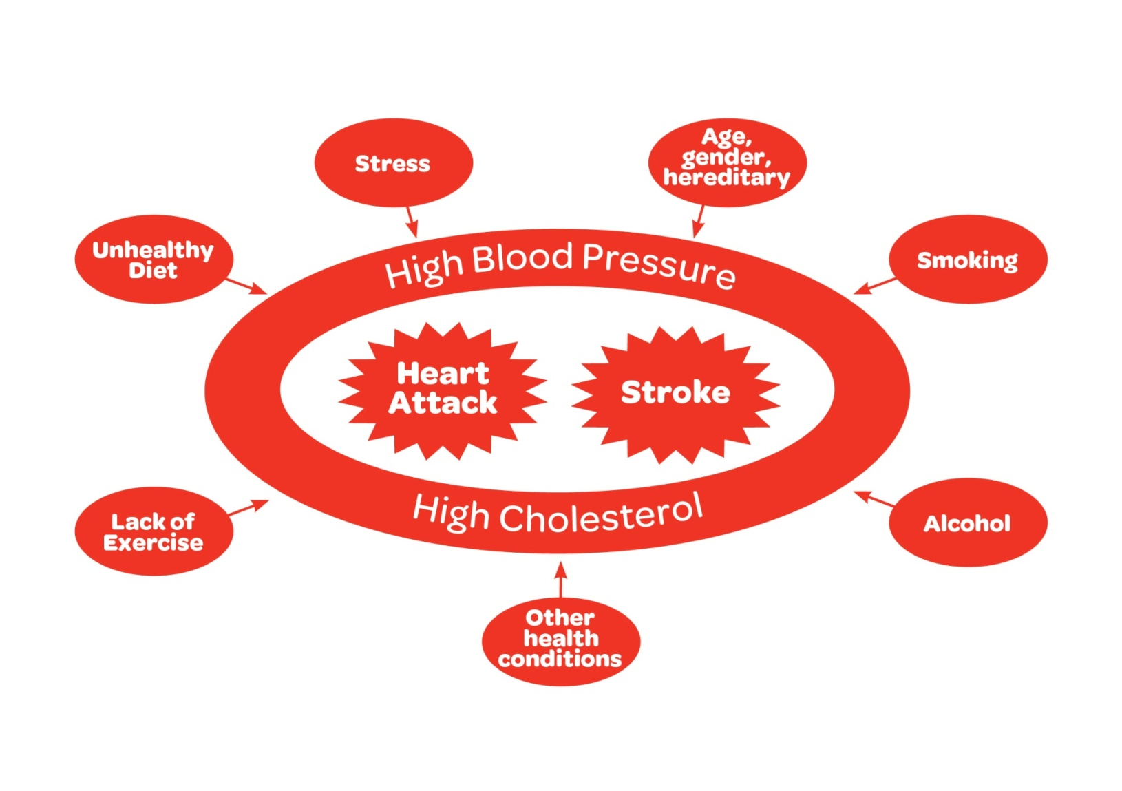
Risk Factors
01
Notes:
Background risk factors are uncontrollable : age, gender, family history, other health conditions
Family
Age – the risk of a heart and stroke increases with age
Gender – men are at more risk of heart disease than women
Ethnic origin – people from afro caribbean or south east asian background have an increased chance of a heart attack or stroke
If you have already had a stroke or heart attack
Family history – if your parents or grandparents had a heart attack or stroke at an early age (under 55 for men and under 65 for women) your own chances will be higher.
Behavioural (i.e. lifestyle choices) risk factors – smoking, alcohol, lack of exercise and unhealthy diet
Intermediate risk factors (i.e. caused by the lifestyle choices) - High blood pressure, high cholesterol, obesity and diabetes
Today we are going to focus at the risk associated with a unhealthy diet to a heart attack and stroke.

Slide 3
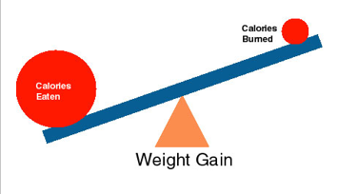
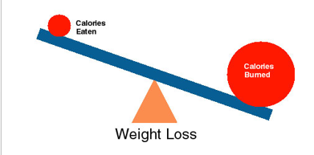
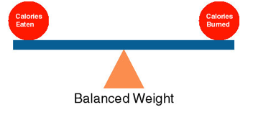
Getting the balance right
02
Notes:
Its all about balance!
If you eat more calories than you burn off in physical activity you will end up carrying too much weight.
If you eat too few calories than you burn through physical activity, then you will lose too much weight and this is just as dangerous as this can lead to poor circulation and lead to coronary heart disease and irregular heart rate.
We also need some fat to keep us warm, give us energy and protect our organs.
You need to balance out the amount of calories eaten and the number of calories burned to maintain a healthy weight.

Slide 4
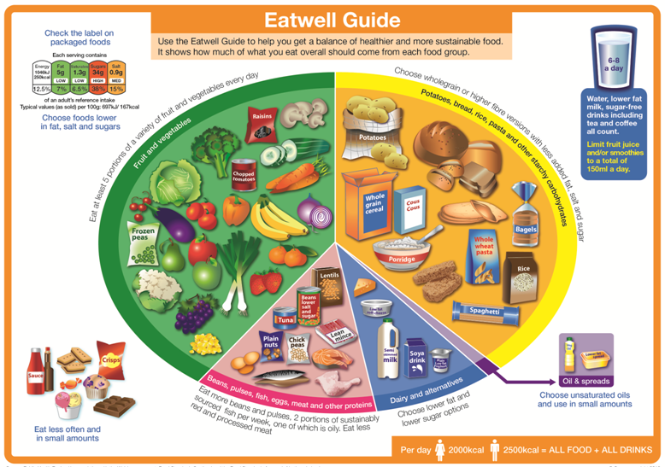
03
Notes:
The `Eatwell Guide' is a really useful tool to help us balance our daily meals. It tells us which food groups to eat and in what amounts.
It is made up of the 5 main food groups:
Fruit and vegetables (5 portions a day: 3 vegetables and 2 fruit and provides vitamins and minerals)
Potatoes, bread rice and pasta (6 portions a day and provide energy and fibre esp. wholegrain and wholemeal varieties) are similar in size and the two biggest groups on the plate meaning we should be eating most of those types of foods.
Beans, pulses, fish, eggs & meat (2-3 portions a day and provide protein and omega 3 fatty acids from fish esp. oily fish which protects the heart) is next in size, and all of these groups portion sizes are the size of the palm of your hand.
Dairy & alternatives (3 portions a day and provides calcium) portion sizes are smaller due to the high fat content e.g. Butter = small match box.
The smallest group is the Oils and spreads, so we shouldn't eat too much of these. This group includes things like vegetable oil, olive oil etc. and flora, benecol, golden olive etc.
These 5 groups are all foods we should be including in a healthy diet. You can see that things such as fluid intake (6-8 glasses each day – coffee and tea contributes to this until 3 cups, after which it dehydrates), calorie intake, foods high in fat, sugars and salt and a labelling guide are also included around the outside.
The foods high in fat, sugars and salt have been placed to the side and out of the “plate” to emphasise that they should be kept as treats and only eaten in small amounts.

Slide 5
Guess the Number of Sugar Cubes
5
14
18.5
2
2
4
04
Notes:
I would like you to guess how many sugar cubes are in each of the products I am about to show you. A sugar cube is about the size of a dice. Adults are only allowed 7 extra sugar cubes per day; 4-6 year olds = 5 per day; 7-10 year olds = 6 per day
Onken Fat-free Strawberry Yoghurt 450g per pot - 5 sugar cubes per 150g serving (once you add flavour you add sugar, therefore choose natural/Greek style yoghurt with natural fruit)
Share packet Jelly Babies – 18.5 (Haribo and Starburst 25 and 40 respectively)
Caramel frappacino - 14 sugar cubes (medium vanilla latte from Costa = 7)
Robertsons Golden Shredless Orange Marmalade - 2 sugar cubes per teaspoon
Nakd Berry Delight Bar - 3 sugar cubes (Mars bar 5, Dairy milk 6)
Original Bolognese sauce - 2 per potion (1/4 jar) - low fat 1 per portion
Mention SugarSmart app - easy to use - good info

Slide 6
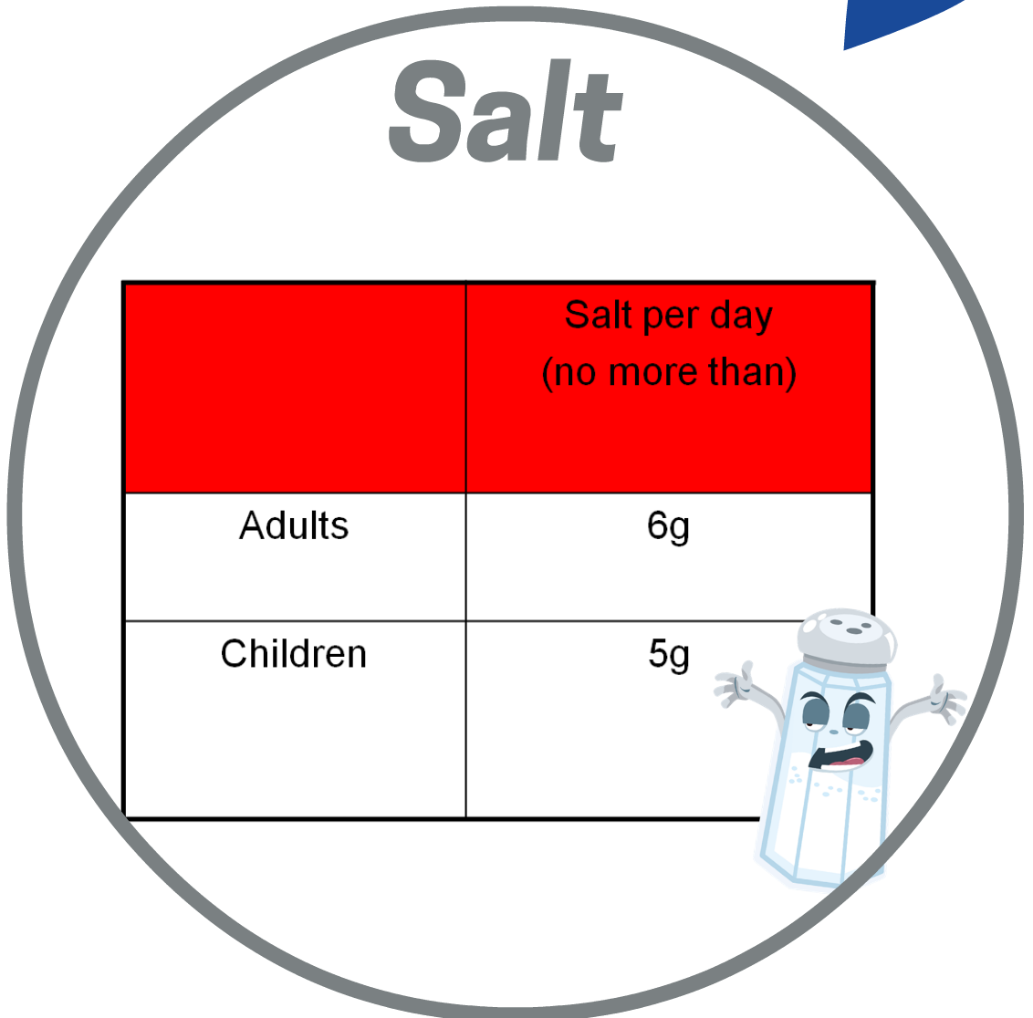
05
Notes:
How many grams of salt should you have in the diet each day? Adults should have no more than 6g a day and kids should have even less. 6g is about one teaspoon.
Too much salt hardens the arteries, making it easier for cholesterol to stick to. If this cholesterol builds up, the arteries become narrowed, making it harder for the blood to flow through the body. This puts pressure on the heart and increases risk of a heart attack and stroke. It also raises blood pressure, because it causes your body to retain more fluid (increases blood volume) thus exerting more pressure on the artery walls.
Food manufacturers often try and hide how much salt they are putting in their products, so they try and confuse the matter by calling it sodium instead. To to work out how much salt is in the product you need to multiply the sodium level by 2.5.
The amount of salt manufacturers put into their food products is more than enough. Therefore try not to add salt to your food. Use herbs and spices instead to add flavour. If you do add salt, try to wean yourself off it. Then you will be more inclined to sustainably stay off it. Ready meals and convenience foods in particular can be very high in salt, so try to avoid these. Salt is also hidden in many foods such as breads, cereal and biscuits, so make sure to always read the label!

Slide 7
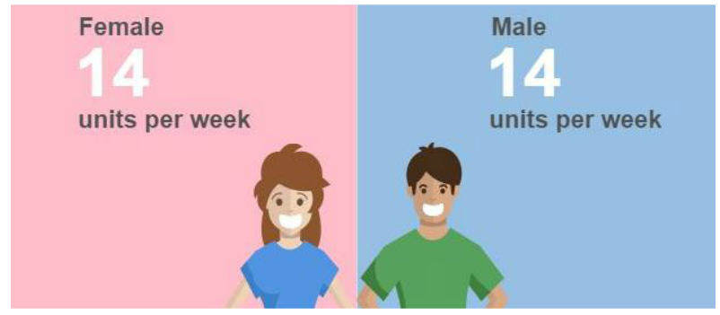
Alcohol
06
Notes:
The new alcohol guidelines are that no more than 14 units of alcohol should be consumed over a 3 day period, with several alcohol free days - so ideally no more than 14 units for the week. This is the same for men and women.
Alcohol is full of `empty calories.' This means that they are high in calories and have no nutritional value to them. Your body will tackle these calories first, as it wants rid of the alcohol as soon as possible, so it will stop the body burning fat for energy. Alcohol also increases blood pressure and cholesterol. Stay within the recommended units.

Slide 8
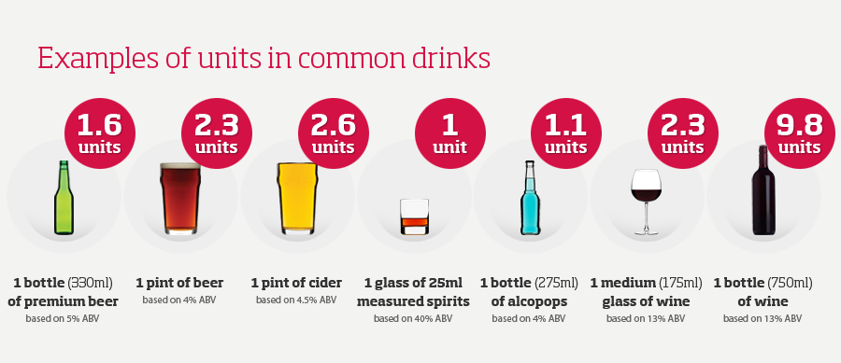
Alcohol (continued)
07

Slide 9
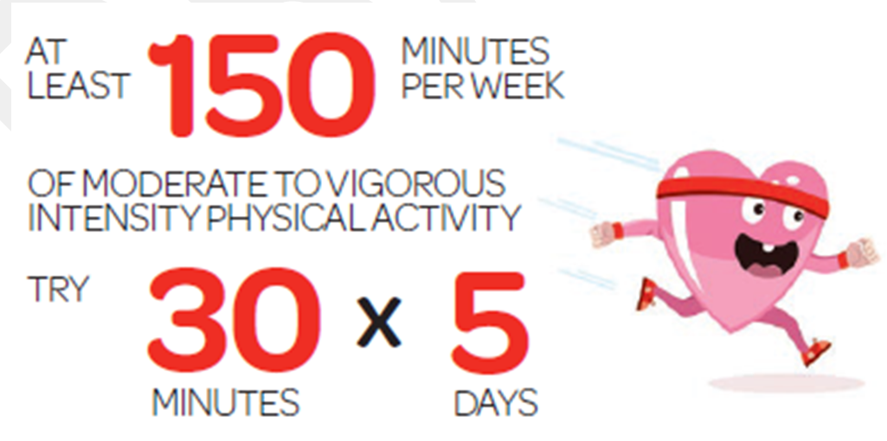
Physical Activity
08
Notes:
Everyone above the age of 18 is the same. We all must get our 30 minutes of moderate intensity 5 times a week which amounts to 150 minutes a week or 75 minutes of vigorous activity, and we will look at the difference between these in a moment. The reason for the recommendations now being 150 minutes is because of `weekend warriors'. So for those who during the week don't have the time to get their physical activity they can do it all at the weekend. However it is important that if you are only starting off, to build your levels of physical activity up slowly and therefore the progress will be more sustainable to reaching the recommendations. For children they should be getting 60 minutes of moderate to vigorous intensity every day.

Slide 10
What is Intensity?
Intensity? - Everyone has different levels of fitness. This means that where one person finds an activity hard, another may find it easy
Moderate Intensity is when your heart beats faster, you sweat but you can still talk | Vigorous Intensity is when your heart beats faster, you sweat a lot and you cant talk
09
Notes:
For everyone different exercises will affect them differently - for example:
For one person walking up a steep hill might be moderate exercise and to another that may be vigorous exercise.
So what does that mean for you?
Moderate Intensity - is when your heart beats faster, you sweat but you can still talk
Vigorous Intensity - is when your heart beats faster, you sweat a lot and you can’t talk
It is important to do a level which suits your own capabilities and again building it up so that it will be more sustainable.

Slide 11
Strengthening Exercises
10
Notes:
It is also important that everyone does strengthening exercises at least 2 days a week. This can be anything as simple as carrying heavy loads e.g. groceries, lifting weights or body weight exercises e.g. stepping, jumping, dancing. We are not asking you to join a gym and start lifting weights. Just simple every day exercises build into your daily routine can have the same beneficial effects.
It is excellent that you are physically active for 30-45 mins but we need to keep moving the rest of the day as you shouldn't sit for more than 2 hours at a time. Our joints and muscles need to keep moving. It is also important that with exercise, you also eat a health balanced diet to stay a healthy weight and help reduce other risk factors such as blood pressure and cholesterol.

Slide 12
11

Slide 13
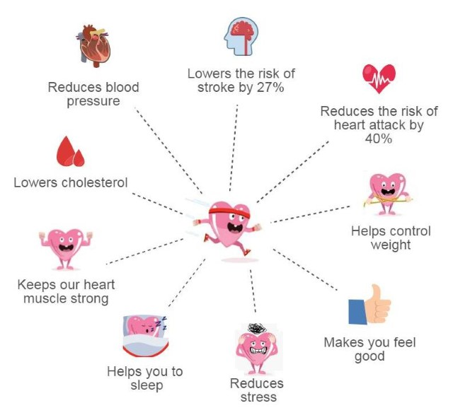
Benefits of Physical Activity
12

Slide 14
In Summary:
Kids
60 mins of P.A
a day
Eat a balanced
diet
Adults
150 mins of PA a week
Cut back on the booze
Stub out smoking
13
Notes:
In summary:
Eat a balanced diet
Children - 60 minutes of moderate to vigorous intensity physical activity a day
Adults – 150 minutes of moderate to vigorous intensity physical activity a week
Stub out smoking
Cut back on the booze

Slide 15
Further Information & Help
Chest Heart and Stroke (also advise and help with cancer) - Advice Line Nurses on 0808 801 0899 or visit chss.org.uk
14

Slide 16
Any Questions?

Slide 17
Thank You

